Slide 1




Development of master curricula for natural disasters risk management in Western Balkan countries
Project based education at Bánki
Vehicle building projects
Dr. Tamas Szakacs
Óbuda University
Faculty of Mechanical and Safety Engineering
Department of Vehicle and Mechatronics
NatRisk/ 2017-05-24
Project number: 573806-EPP-1-2016-1-RS-EPPKA2-CBHE-JP
"This project has been funded with support from the European Commission. This publication reflects the views only of the author, and the Commission cannot be held responsible for any use which may be made of the information contained therein"

Slide 2
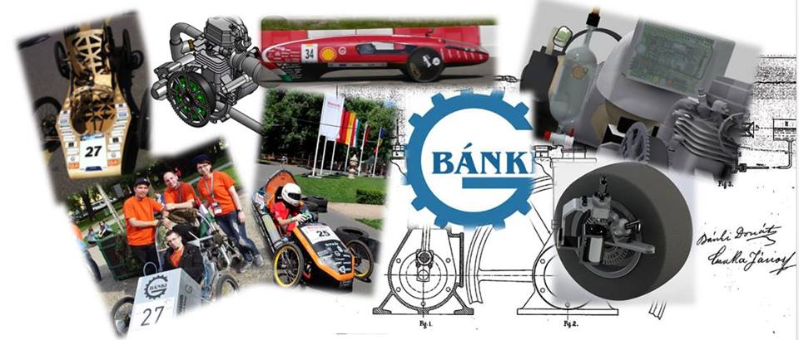
Vehicle Projects
Development of master curricula for natural disasters risk management in Western Balkan countries
Shell Eco-marathon
Pneumobil
Electromobil
Bosch Gokart

Slide 3
Shell Eco-marathon
Development of master curricula for natural disasters risk management in Western Balkan countries
OECO Team
Kerekes Attila +
Nyári Péter

Slide 4
Shell Eco-marathon
Development of master curricula for natural disasters risk management in Western Balkan countries
The longest distance taken by 1lE95 equivalent fuel.
Average 220 teams / Europe
international, student competition
University of Obuda team OECO is taking part since 10 years
Recent results
2015: 565,3 km/l (absolute 14th place, in own category 3rd )
2014: 434 km/l (absolute 23 th place, in own category 4th)
2013: 565,5 km/l (absolute 19 th place, in own category 7th)

Slide 5
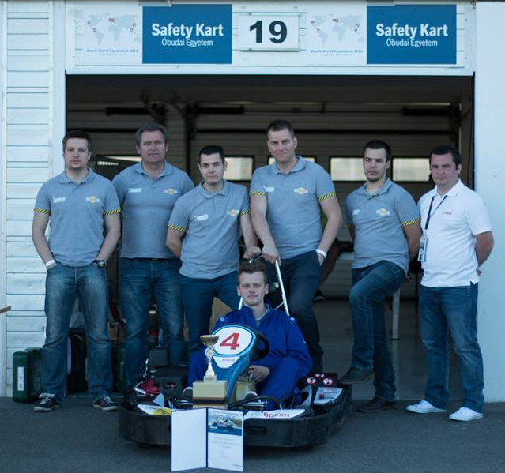
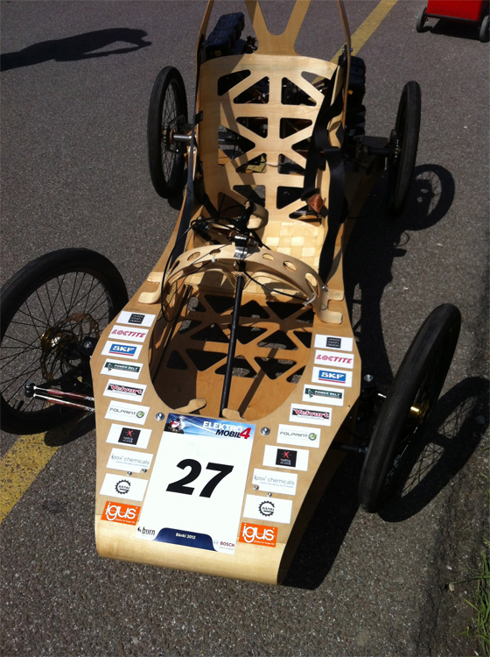
Development of master curricula for natural disasters risk management in Western Balkan countries
OE Safety Kart
(Bosch Gokart)
Bosch Electromobil

Slide 6
OE Safety Kart
(Bosch Gokart)
Development of master curricula for natural disasters risk management in Western Balkan countries
A three-year project ended in 2016.
Results
    2014: The best tecnical solution: 2nd place
2016: Efficient go-kart category: 1st place
In total: 3rd place

Slide 7
Pneumobil projects
(Aventics)
Development of master curricula for natural disasters risk management in Western Balkan countries
Pneumobil is a compressed gas powered vehicle. As fuel 10 liter of 200bar compressed nitrogen is used.
According to the technical specification linear pneumatic cylinders must be used to provide driving force.
First year of competition has been organized in 2008. University of Obuda is participating the race since the very beginning. In the recent 3 years over 60 teams from 7-8 countries are signing for the race, but less then 50 are making till the startline. The rest fall out during the license phase.

Slide 8
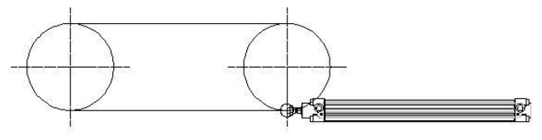
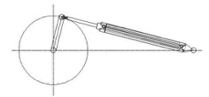

Pneumatic engines
Development of master curricula for natural disasters risk management in Western Balkan countries
Endless chain
Camshaft mechanizms
Rag and pinion mechanisms
Bilateral motion of piston
High primar motion is the goal
Belt, chain, or cable mechanism
Linear motion of cylinder is converted to rotational motion
1- 2- 3 or , ‚n’ pistons
Advantages:
  Very simple (1 pison)
  Flexible engine (2 pisons)
  Smooth run (3 pistons)
Advantages (in amongs):
  Even torque independent from the numer of cylinders
Disadvantages:
  Requires a free wheel
  There is a dead center position at both stroke ends

Slide 9
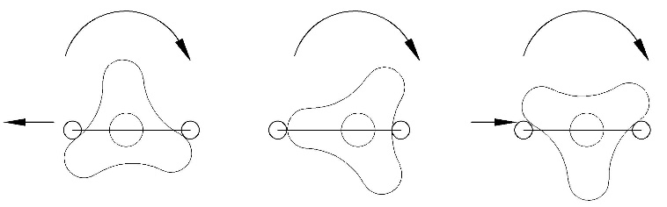
Coulissee engine
Development of master curricula for natural disasters risk management in Western Balkan countries
Three egde rotating disk engine each disk has one, or on both sides two engines.
Coulisse layout
Coulisse drives the disk by bearings
3 piston strokes resulting one rotation.
Our team had a car in 2011 with this engine

Slide 10
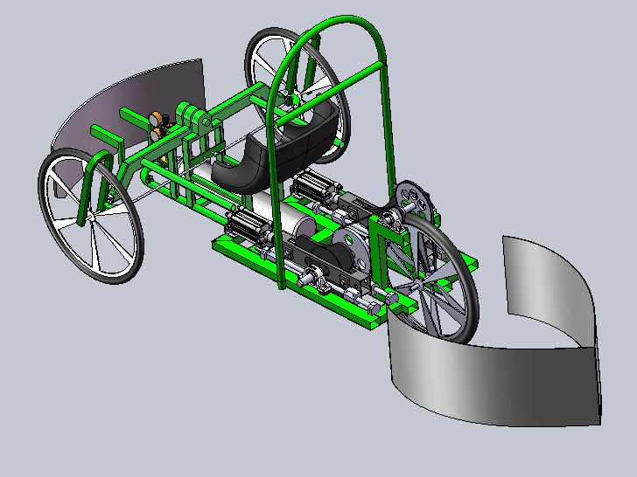
Coulisse engine car
Development of master curricula for natural disasters risk management in Western Balkan countries

Slide 11
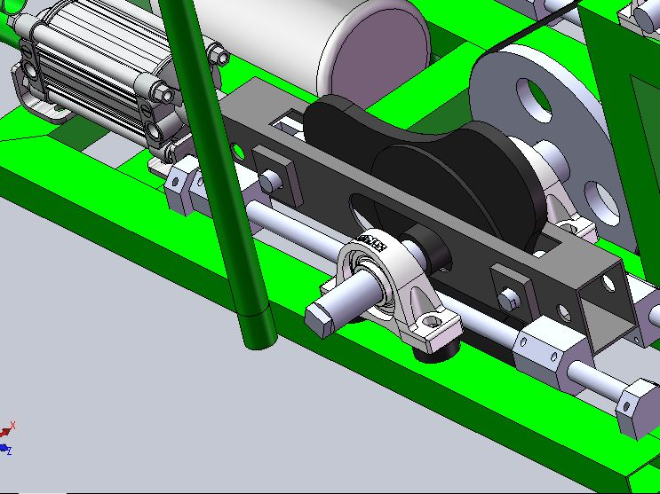
Coulisse engine
Development of master curricula for natural disasters risk management in Western Balkan countries

Slide 12
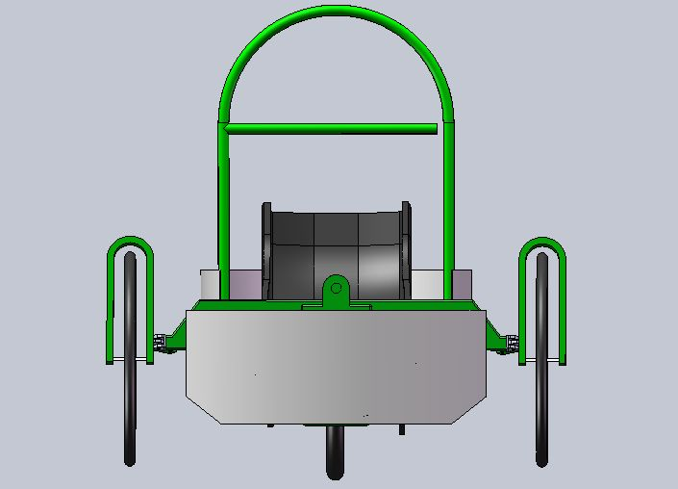
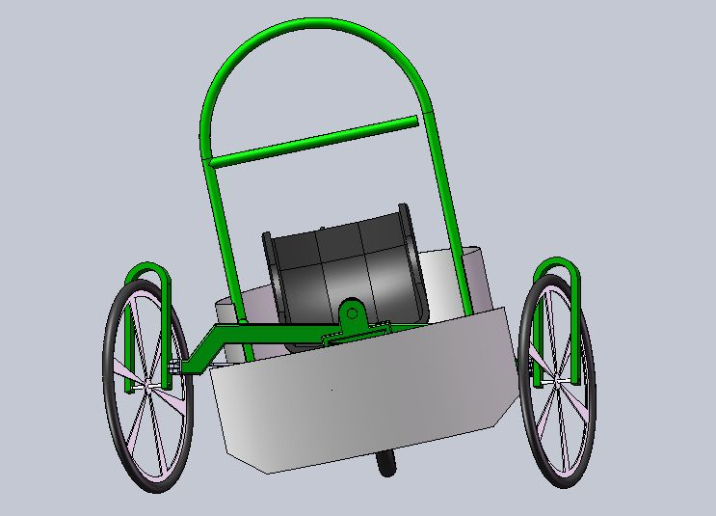
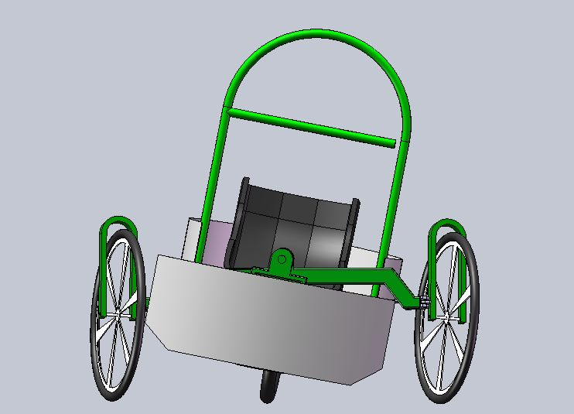
Coulisse engine car
Development of master curricula for natural disasters risk management in Western Balkan countries

Slide 13
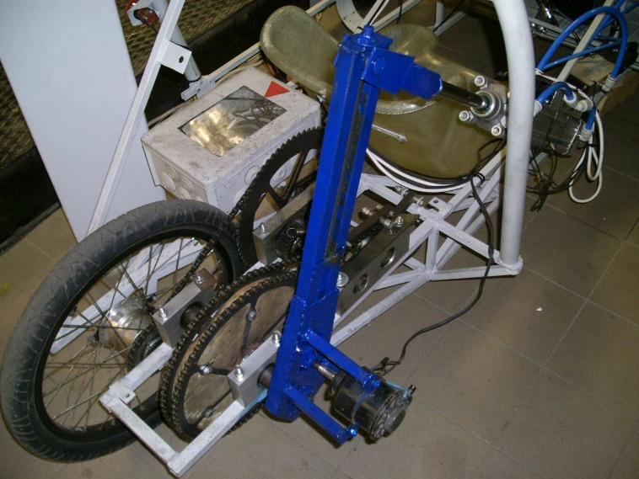
Swing-arm engine
Development of master curricula for natural disasters risk management in Western Balkan countries
In the year 2012 the team brought up a new idea, the swing arm engine
Adjustable arm length
Intinitevly variable transmission

Slide 14
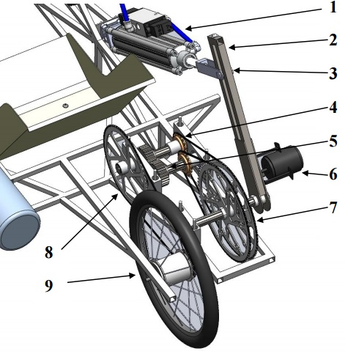
Development of master curricula for natural disasters risk management in Western Balkan countries
Parts list:
Pistin and valve unit
Swingarm, with trapezoid pinoin
Piston rod connection with trapezoid nut
Free wheel
Teethweel pair
Electric motor
Drive wheel
Potrution wheel
Rear wheel with planetary 8 ger gearshift

Slide 15
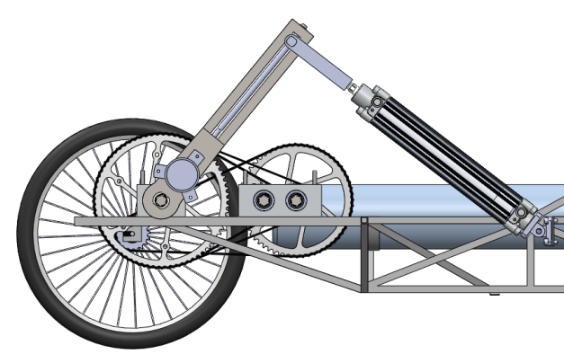
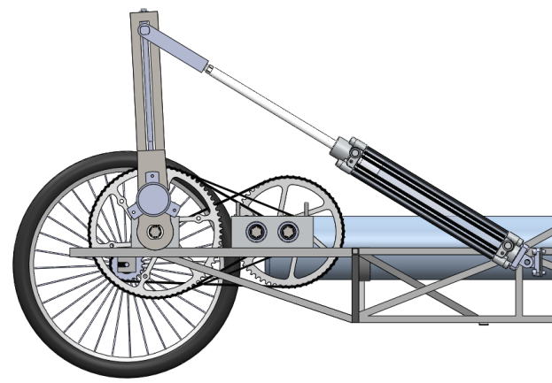
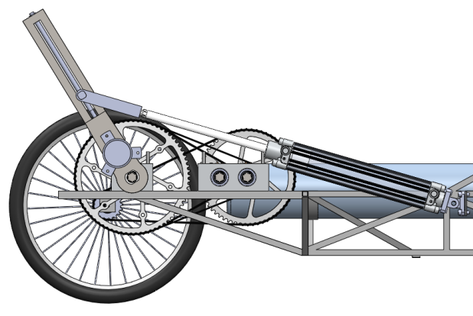
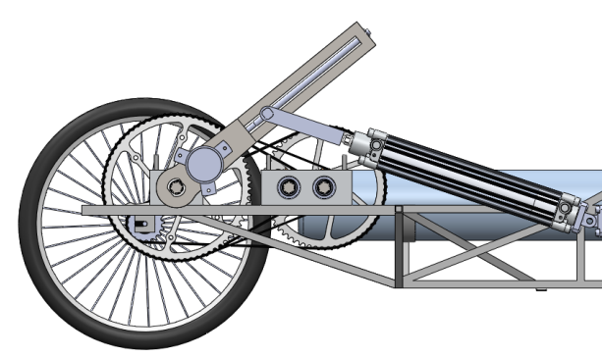
Development of master curricula for natural disasters risk management in Western Balkan countries
Swing-arm engine

Slide 16
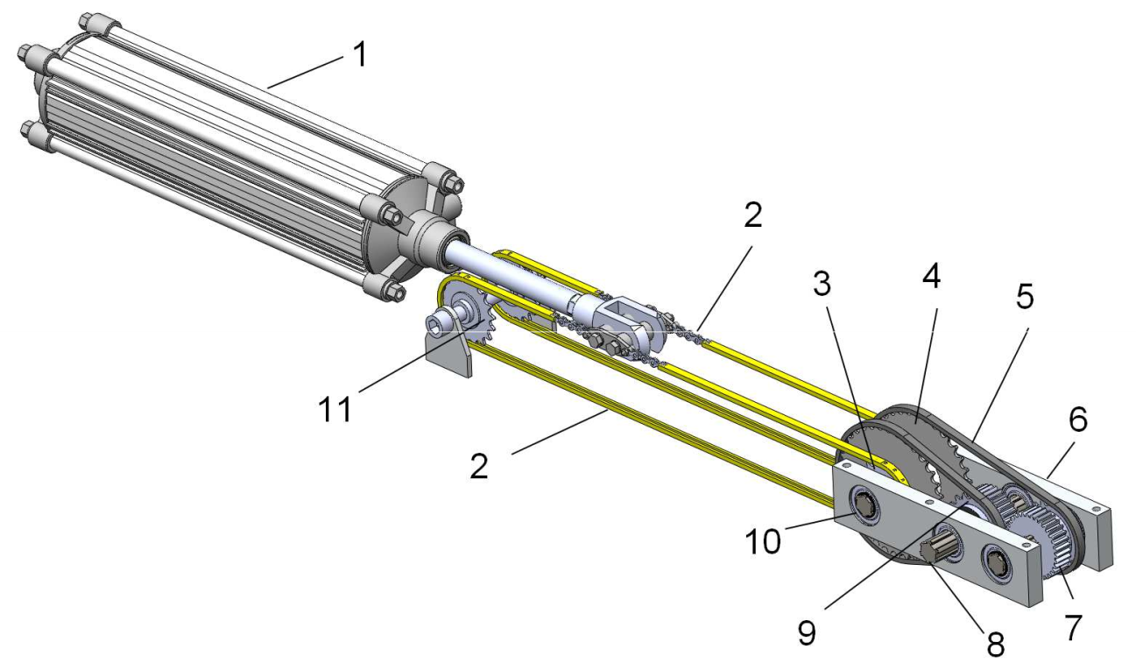
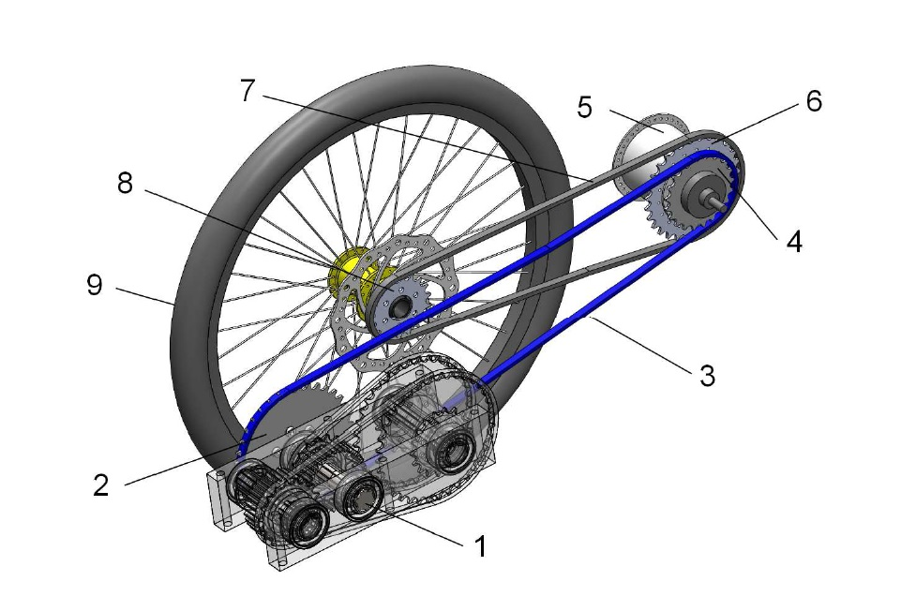
Development of master curricula for natural disasters risk management in Western Balkan countries
Endless chain linear mechanizm

Slide 17




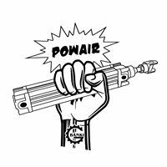
Steering
Development of master curricula for natural disasters risk management in Western Balkan countries
Mechanic (OE Lezs-Air 2016)
Electric (OE Science’s Kitchen 2011)
PLC
Microcontroller
Eletropneumatic OE Belle-Air 2015-16

Slide 18
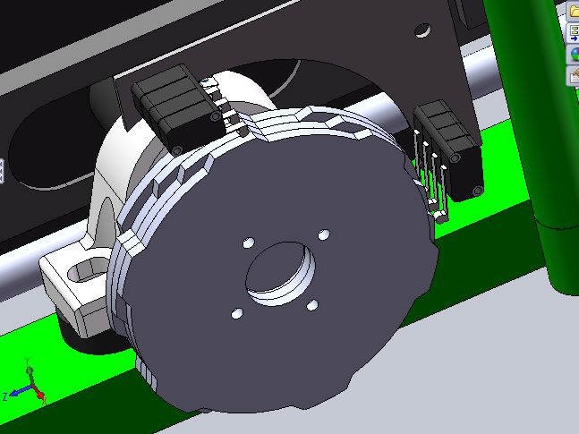
Electromechanic Engine Control
Development of master curricula for natural disasters risk management in Western Balkan countries

Slide 19
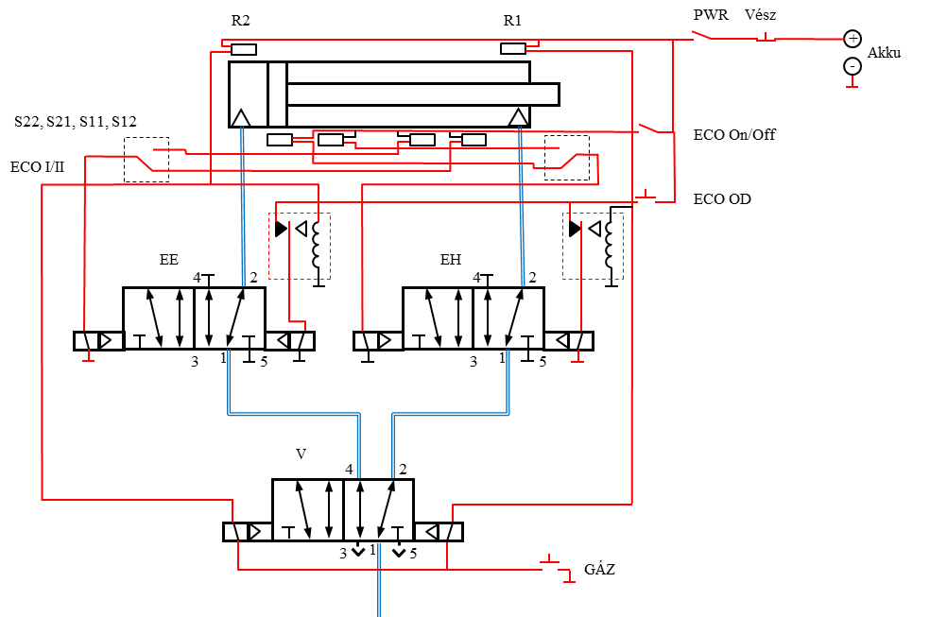
Eletropneumatic
Belle-Air 2015-16
Development of master curricula for natural disasters risk management in Western Balkan countries

Slide 20
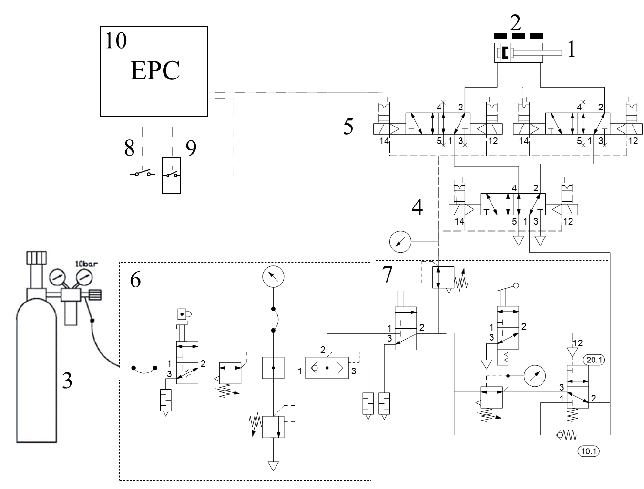
Eletropneumatic
Belle-Air 2015-16

Slide 21
Mechanical loss minimization
Development of master curricula for natural disasters risk management in Western Balkan countries

Slide 22
Mechanical loss minimization
Development of master curricula for natural disasters risk management in Western Balkan countries

Slide 23
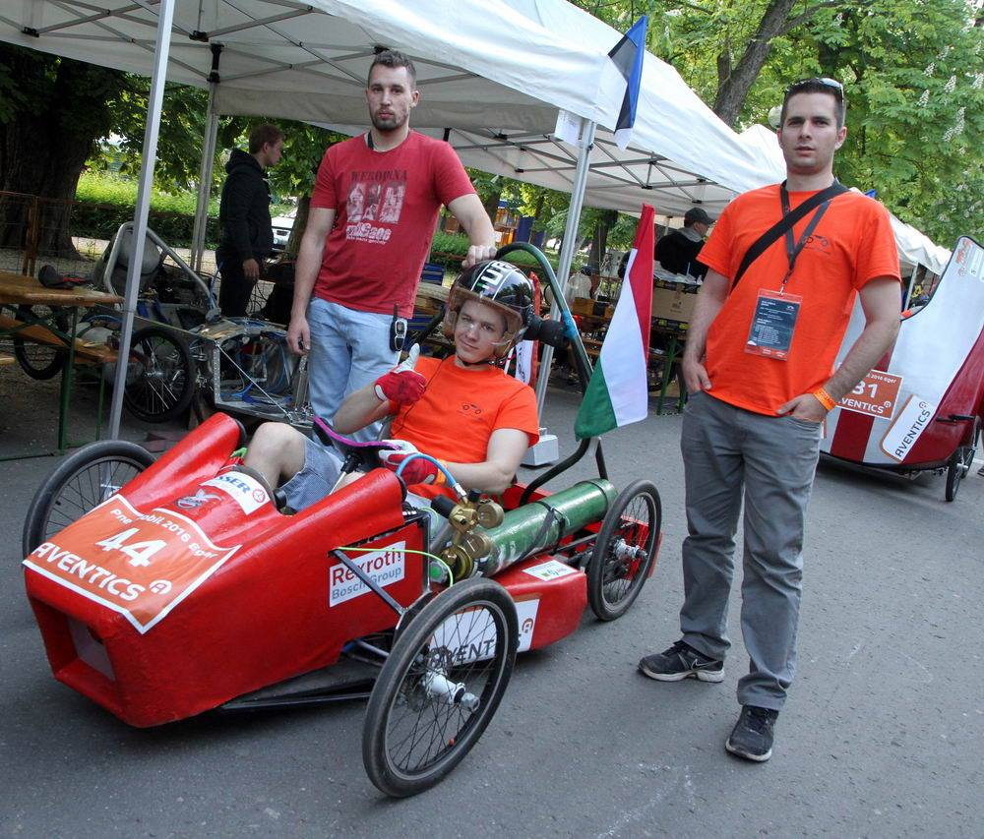
ECO-modes
Development of master curricula for natural disasters risk management in Western Balkan countries
The economy is the keyword from the beginning of the race series.
To measure this therefore is the long distance race.
The minimum average track speed must be arrived
To make utilise the last drop of energy is the goal in this race
Al teams are calling this control mode ECO
No mufflers are used.

Slide 24
Classification
Development of master curricula for natural disasters risk management in Western Balkan countries
Compound arrangement
Multyply expansion
Closing the piston supply (Expansion mode)
The most common ECO mode
The enclosed gas pushes the rot further, while the gas expandes politropically
Ideallically till stroke eng pushed rod
At extra load it may not push till end of stroke
Load sensing, pressure sensing, or stroke sensing can solve the problem
The exhaust gas of primer piston can be used again for the secundary puiston
This is not so good soulition as for steam engines
Increased losses
Not in use by OE pneumobil teams
Multiply pressurising, and expanding
No piston stalls
Special hassing sound

Slide 25
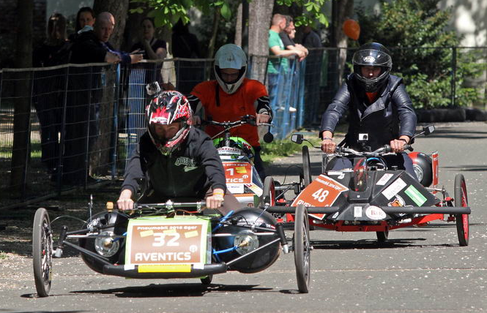
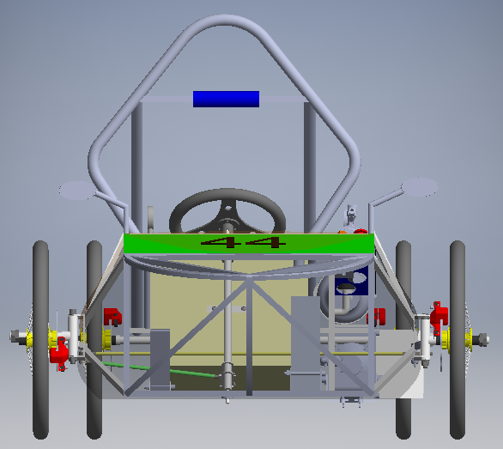
Constructions
Development of master curricula for natural disasters risk management in Western Balkan countries
Gokart/Quad type
Main advantage of gokart type is the higher safety

Slide 26
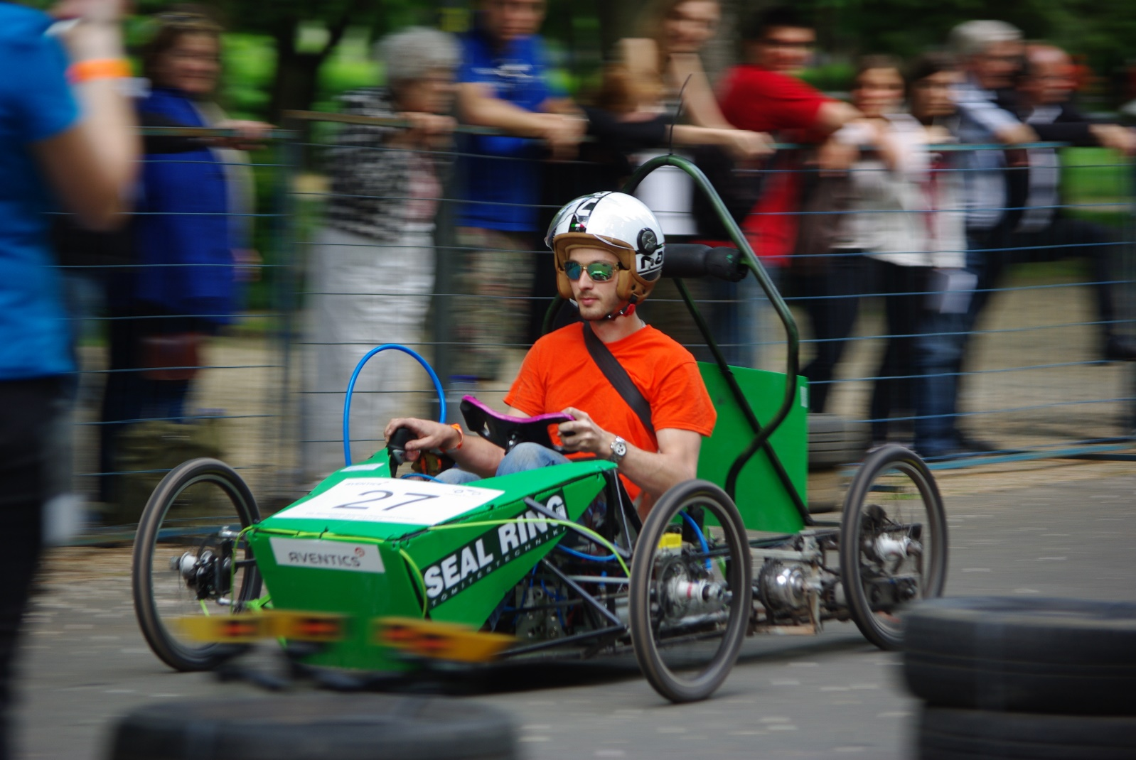
Belle-Air Brúsz
Eger 2015
Development of master curricula for natural disasters risk management in Western Balkan countries

Slide 27


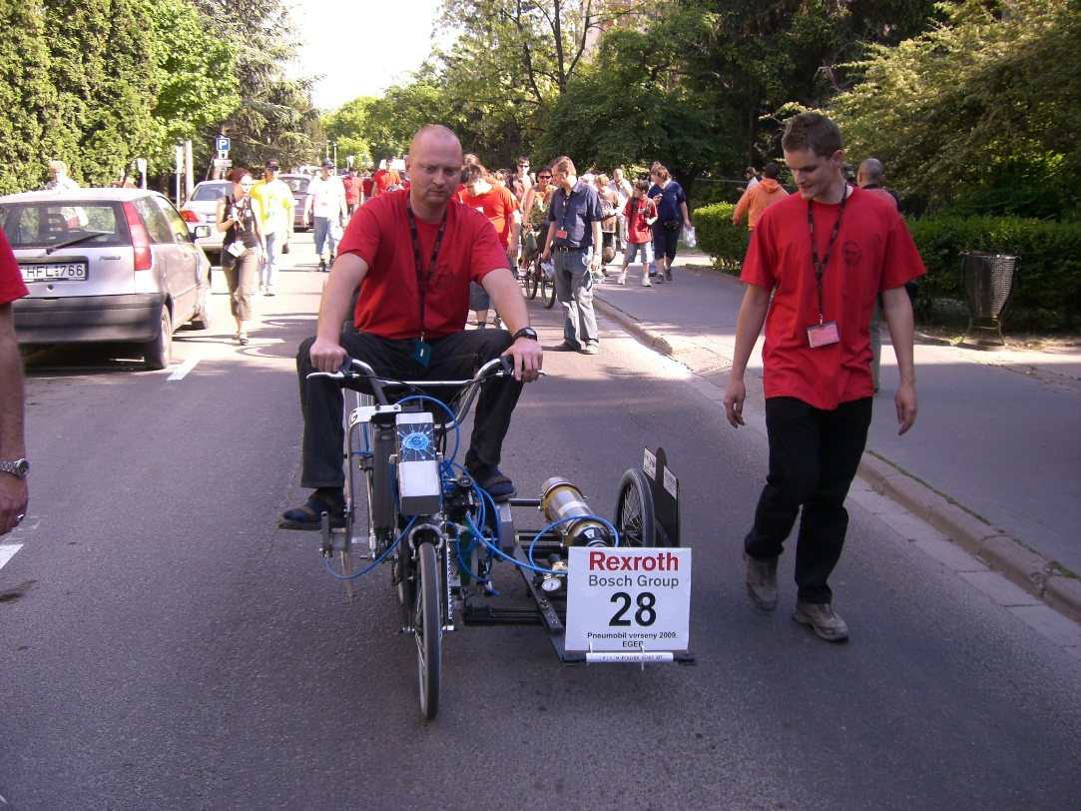
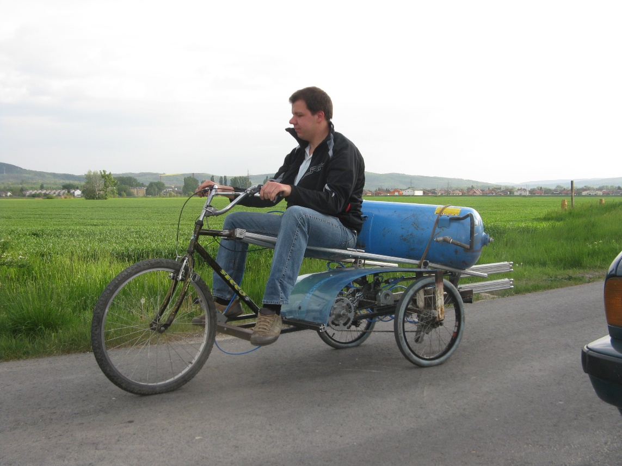
Brainstorming
2009-2010

Slide 28
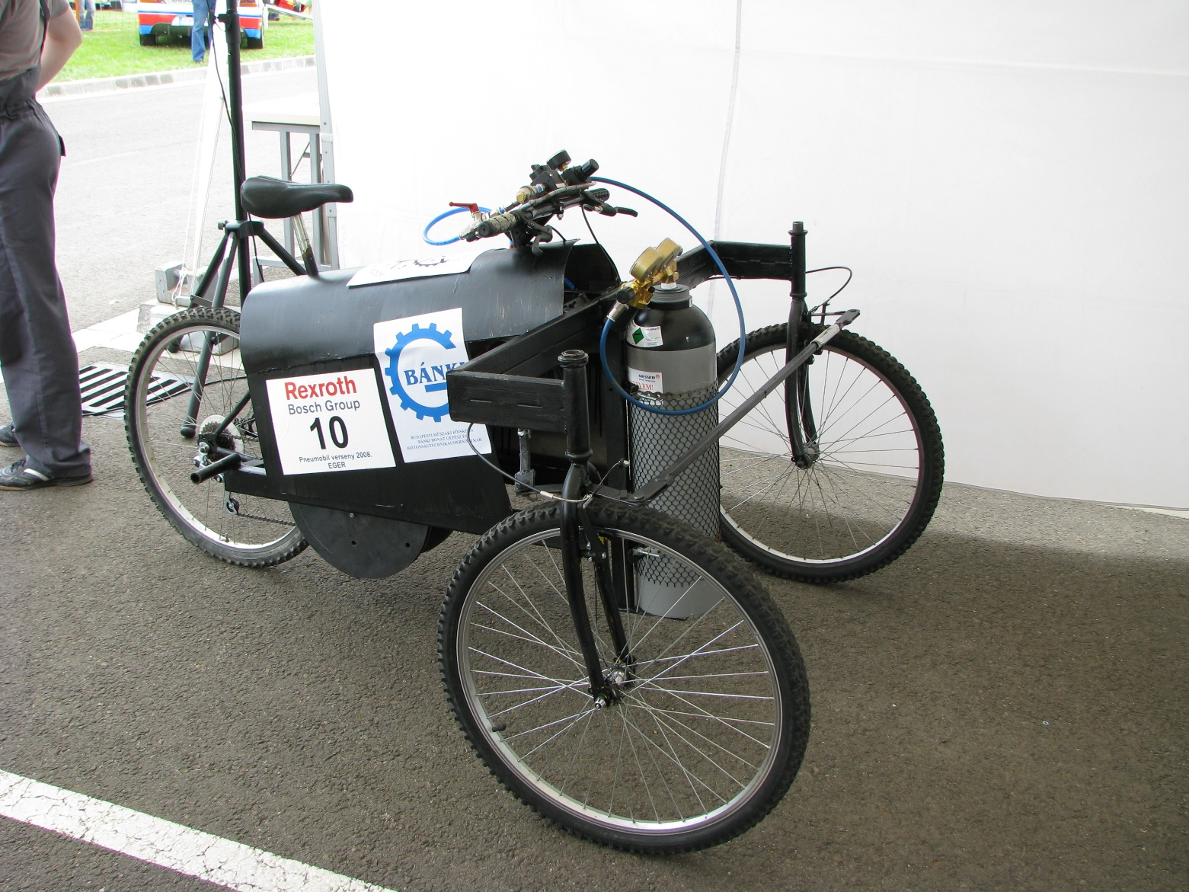
Airbag car 2008
Development of master curricula for natural disasters risk management in Western Balkan countries

Slide 29
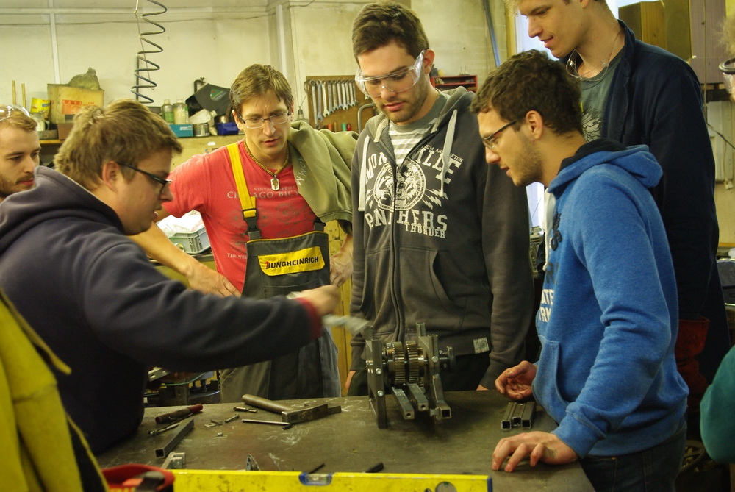
Development of master curricula for natural disasters risk management in Western Balkan countries

Slide 30
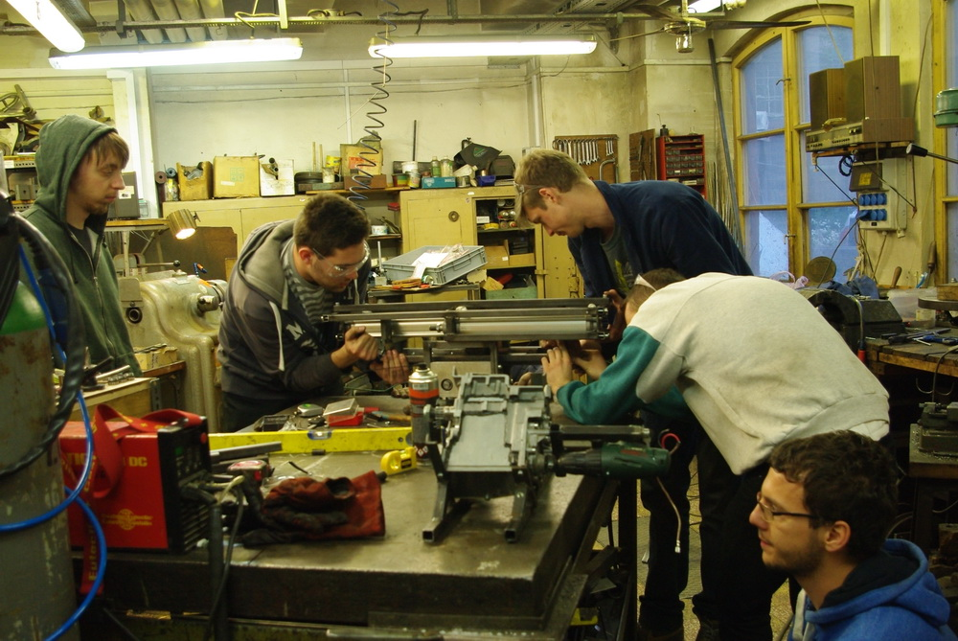
Development of master curricula for natural disasters risk management in Western Balkan countries

Slide 31
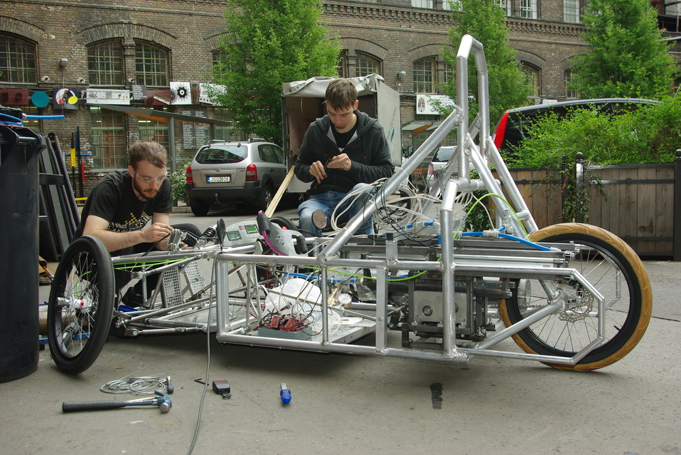
Development of master curricula for natural disasters risk management in Western Balkan countries

Slide 32
Development of master curricula for natural disasters risk management in Western Balkan countries

Slide 33
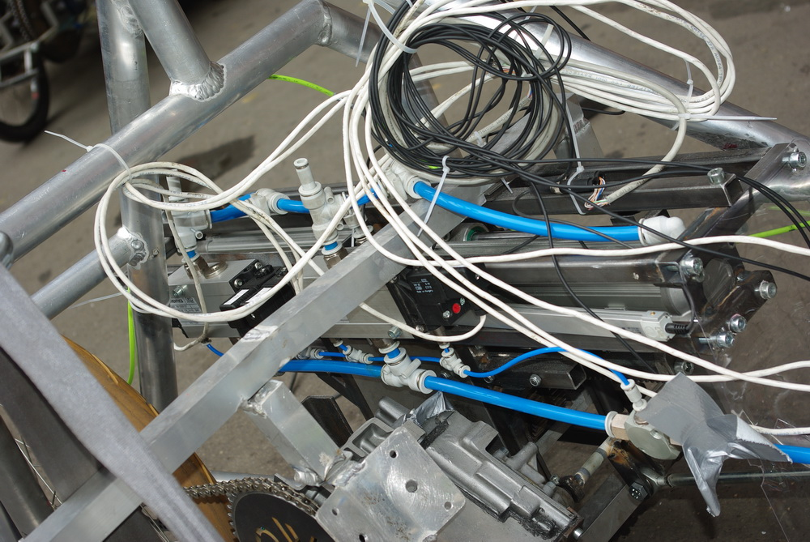
Development of master curricula for natural disasters risk management in Western Balkan countries

Slide 34
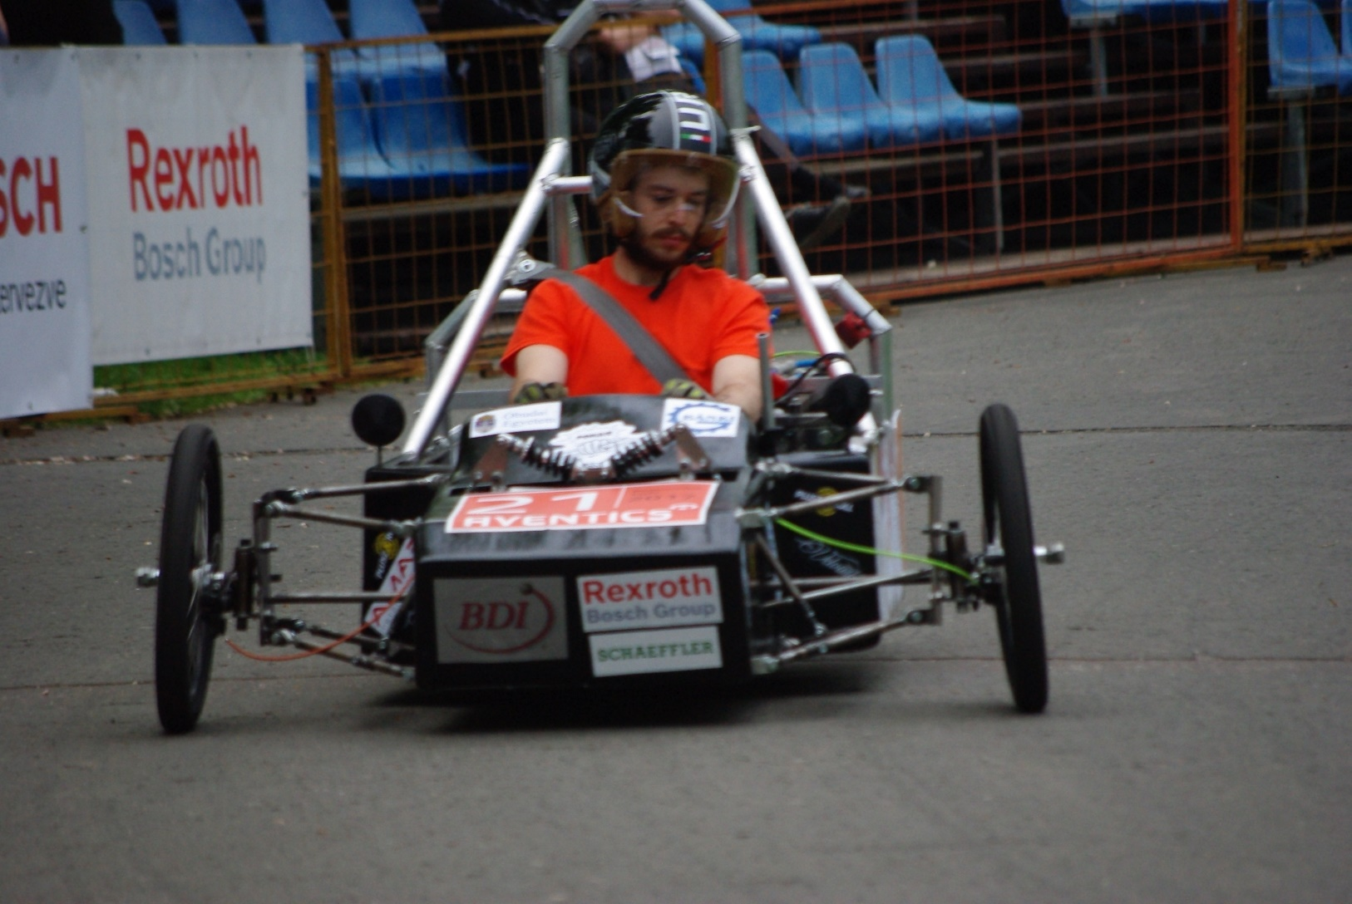
Development of master curricula for natural disasters risk management in Western Balkan countries

Slide 35
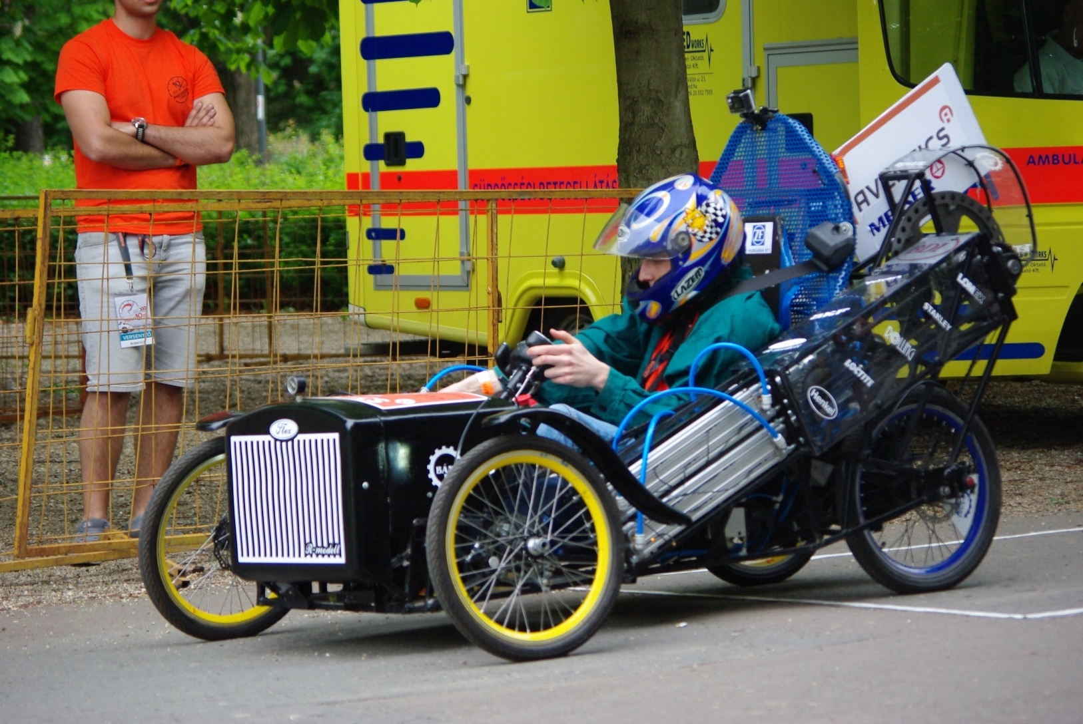
Development of master curricula for natural disasters risk management in Western Balkan countries

Slide 36
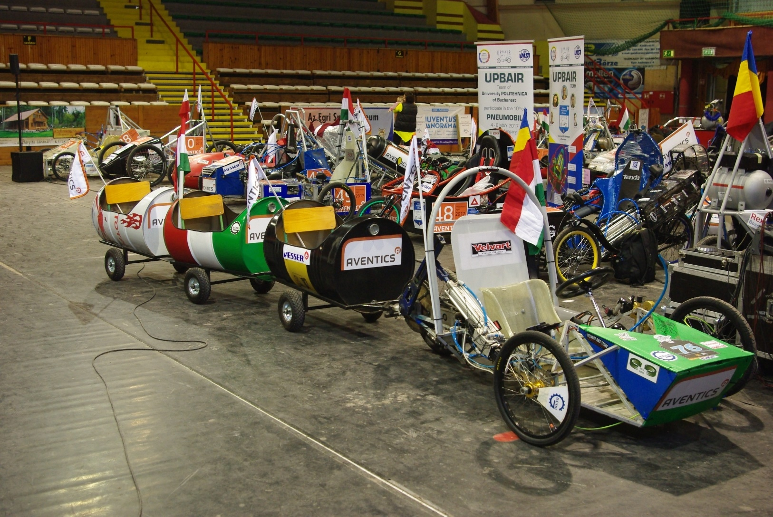
Development of master curricula for natural disasters risk management in Western Balkan countries

